Slide 1
Simulink for Production Software Development: ISO 26262
By Author

Slide 2
Agenda
10:00 - 11:00 Model-Based Design for ISO 26262
11:00 - 11:15 Coffee Break
11:15 - 12:30 Using Simulink for Software Design
12:30 - 13:30 Lunch
13:30 - 15:00 Design Verification
15:00 - 15:15 Coffee Break
15:15 - 16:15 Code Verification
16:15 - 16:30 Summary and Close

Slide 3
Agenda: Model-Based Design for ISO 26262
Tool classification and qualification
Certification kit introduction
Project planning
Tool qualification plan
Conformance demonstration templates

Slide 4
High-Integrity Workflows (ISO 26262)
High-Integrity Applications / Safety Standards / ISO 26262
MathWorks Support for ISO 26262
ISO 26262 and Model-Based Design

Slide 5
High-Integrity Workflows (ISO 26262)
High-Integrity Applications / Safety Standards / ISO 26262
MathWorks Support for ISO 26262
ISO 26262 and Model-Based Design

Slide 6




High-Integrity Applications
Software-based systems that are designed and maintained such that they have a high probability of carrying out their intended function
cf. Buncefield Investigation Glossary www.buncefieldinvestigation.gov.uk/glossary.htm
Notes:
Original definition:
High integrity systems
Systems that are designed and maintained so that they have a high probability of carrying out their intended function. Safety instrumented systems having safety integrity levels in the range SIL1 to SIL4 are regarded as high integrity systems

Slide 7
High-Integrity Applications
Following Standards and Guidelines
Regulate development of high-integrity applications
Define:
Objectives for development process activities
Requirements for tools used in these development processes (tool qualification)
User needs to demonstrate that the objectives and requirements were met (compliance demonstration)

Slide 8
ISO 26262 “Road Vehicles - Functional Safety”
Emerging functional safety standard for passenger cars
Facilitates modern software engineering concepts such as
Model-Based Design
Early verification and validation
Code generation
Provides objectives / requirements for
Development process activities (software safety life cycle)
Development and verification tools (tool qualification)
Notes:
ISO 26262 contains guidelines on how to detemine the ASIL level.
Usually the applicant needs to select the appropriate ASIL level for their system at the beginning of the safety life cylce.
The cert authorithy or internal cert department needs to approve the ASIL classification.
For sw development, we assume that the ASIL level has been already determined.
Mention (non) correspondence of SIL and ASIL levels in voice over.

Slide 9
ISO 26262 Structure
ISO 26262-1
Vocabulary
ISO 26262-2
Management of functional safety
ISO 26262-3
Concept phase
ISO 26262-4
ISO 26262-5
ISO 26262-6
ISO 26262-7
Product development: system level
Product development: hardware level
Product development: software level
Production and operation
ISO 26262-8
ISO 26262-9
ISO 26262-10
Supporting processes
ASIL-oriented and safety-oriented analyses
Guideline
Model-Based Design
Early verification and validation
Code generation
Tool classification and qualification
Notes:
ISO 26262 dash 6 is concerned with software development processes and includes information on the usage of MBD, early V&V (such as testing at the model level) and PCG
Part 8 is covers among other supporting processes tool qualification topics

Slide 10
High-Integrity Workflows (ISO 26262)
High-Integrity Applications / Safety Standards / ISO 26262
MathWorks Support for ISO 26262
ISO 26262 and Model-Based Design

Slide 11
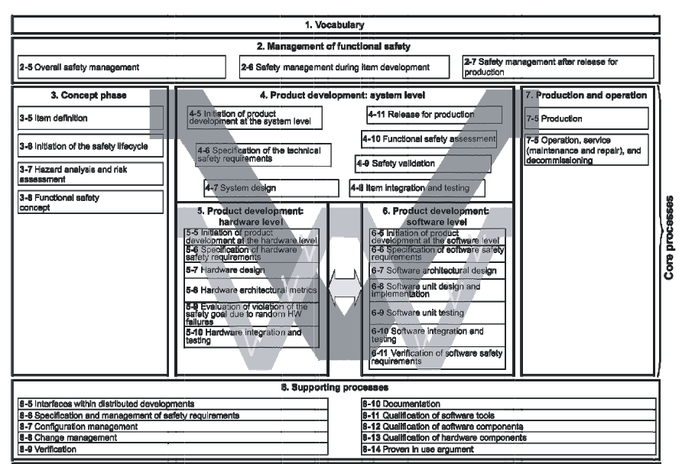
ISO 26262 and Model-Based Design
Model-Based Design is deeply rooted in ISO 26262
Sections concerned with
Model-Based Design

Slide 12

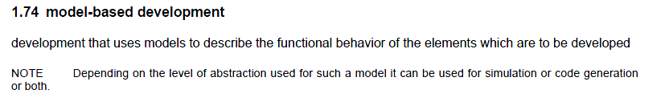
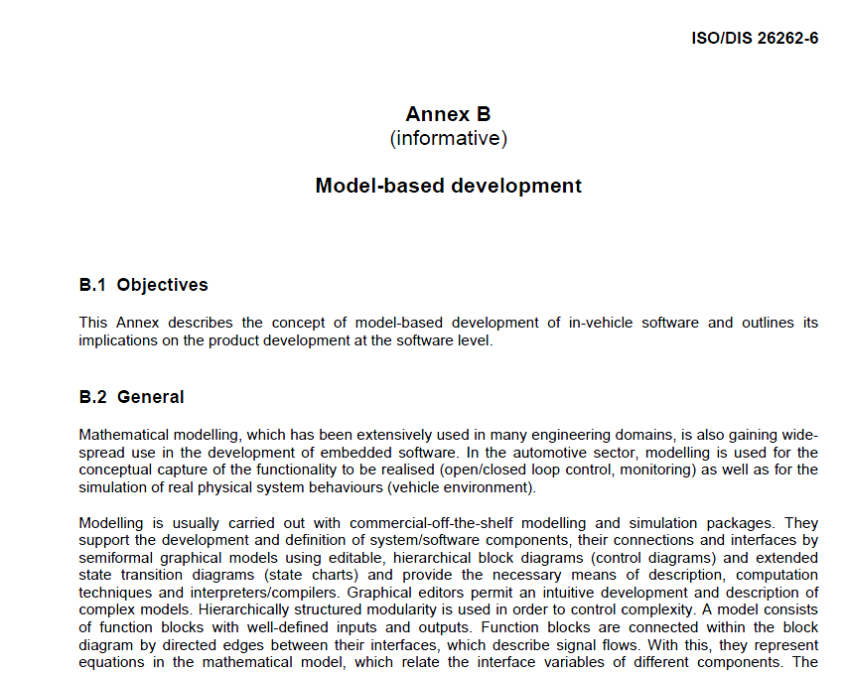
ISO 26262 and Model-Based Design
Model-Based Design is deeply rooted in ISO 26262
The seamless utilisation of models facilitates a highly consistent and efficient development.

Slide 13
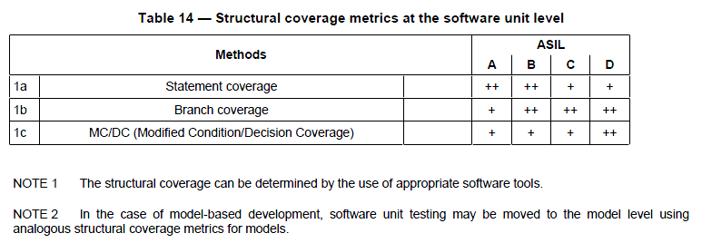
ISO 26262 and Model-Based Design
ISO 26262-6 enables code generation and early verification and validation
Notes:
Part 6 contains an entire annex on MBD. This annex emphasizes the advantages of using models and MBD.
In multiple places, ISO 26262-6 provides specific guidance for MBD activities. The example shows that model coverage metrics could replace code coverage metrics during unit testing when using MBD.

Slide 14
ISO 26262 and Model-Based Design
ISO 26262-6 enables code generation and early verification and validation
Notes:
Part 6 contains an entire annex on MBD. This annex emphasizes the advantages of using models and MBD.
In multiple places, ISO 26262-6 provides specific guidance for MBD activities. The example shows that model coverage metrics could replace code coverage metrics during unit testing when using MBD.

Slide 15
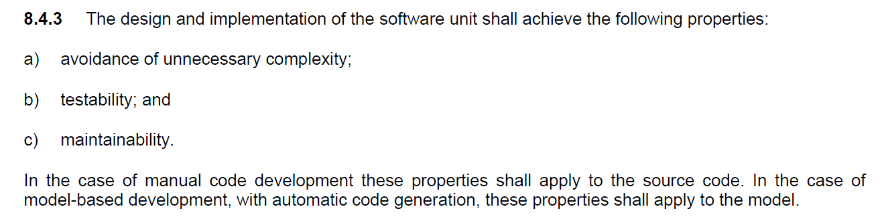
ISO 26262 and Model-Based Design
ISO 26262-6 enables code generation and early verification and validation
[…]
In the case of model-based development, with automatic code generation, these properties shall apply to the model.
Notes:
Part 6 contains an entire annex on MBD. This annex emphasizes the advantages of using models and MBD.
In multiple places, ISO 26262-6 provides specific guidance for MBD activities. The example shows that model coverage metrics could replace code coverage metrics during unit testing when using MBD.

Slide 16
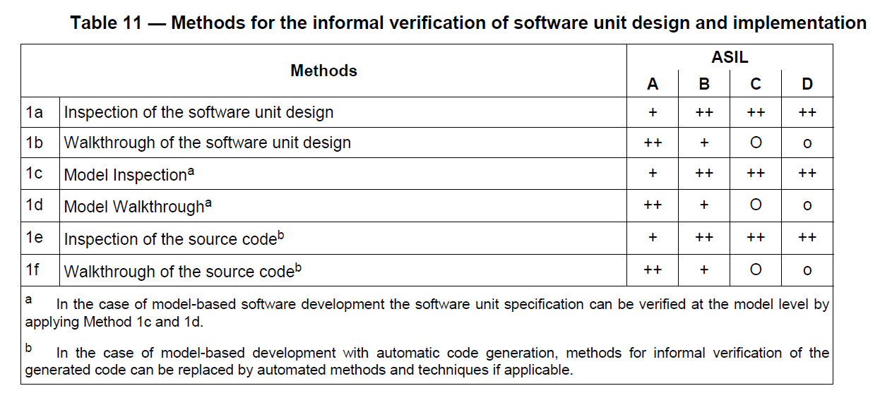
ISO 26262 and Model-Based Design
ISO 26262-6 enables code generation and early verification and validation
Notes:
Part 6 contains an entire annex on MBD. This annex emphasizes the advantages of using models and MBD.
In multiple places, ISO 26262-6 provides specific guidance for MBD activities. The example shows that model coverage metrics could replace code coverage metrics during unit testing when using MBD.

Slide 17
Model-Based Design and ISO 26262 Summary
Model-Based Design is one of the software development paradigms explicitly addressed in ISO 26262
Model-Based Design workflows are integral part of ISO 26262-6
Modeling
Code generation
Early verification and validation
ISO 26262 does not favor code-based V&V over model-based V&V

Slide 18
High-Integrity Workflows (ISO 26262)
High-Integrity Applications / Safety Standards / ISO 26262
MathWorks Support for ISO 26262
ISO 26262 and Model-Based Design
Tool Qualification Support
Model-Based Design Workflow and Tool Chain

Slide 19
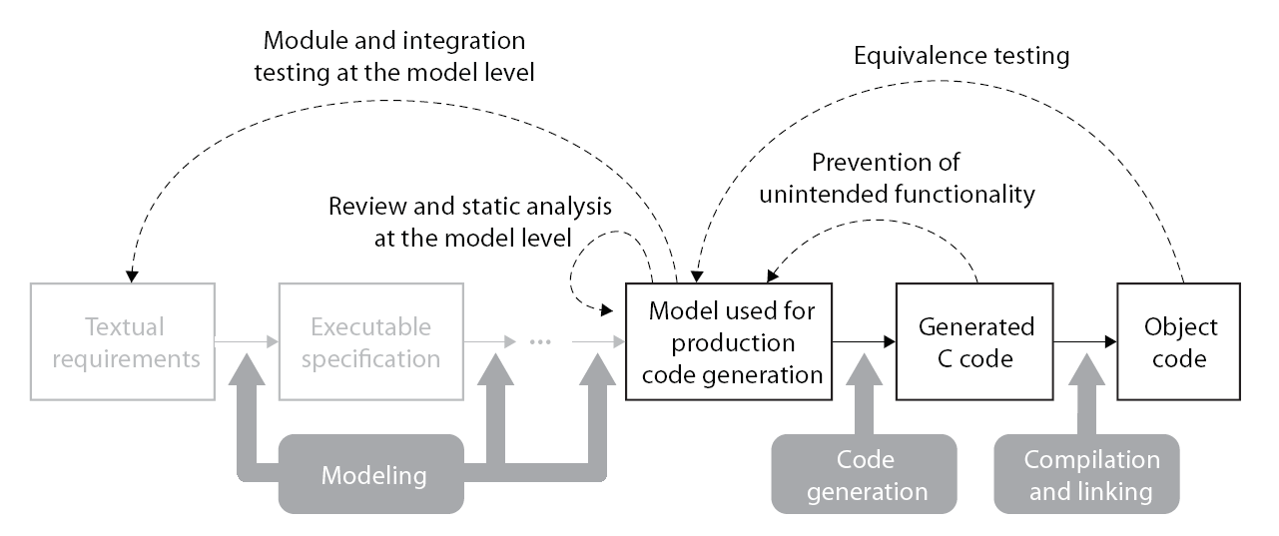
ISO 26262 Reference Workflow
Certifiable Model-Based Design Workflow to develop software according to ISO 26262
Reviewed and approved by TÜV SÜD certification authority
Focusses on quality improvements by systematic verification and validation of models and generated code
Notes:
Quality comes from the process not from the tools
„certifiable workflow“ that also improves the quality
Tool qual improves confidence but not neccessarily quality
- Tool Chain example (not all steps/tools are mandatory)
- Integrated tool chain, covering both Software development as well as verification and validation)

Slide 20
ISO 26262 Reference Workflow Verification and Validation of Models and Generated Code
Model Verification
Code Verification
Discover design errors at design time
Gain confidence in the generated code
Notes:
- Tool Chain example (not all steps/tools are mandatory)
- Integrated tool chain, covering both Software development as well as verification and validation)

Slide 21

ISO 26262 Reference Workflow Example Tool Chain
MathWorks provides an integrated tool chain for ISO 26262
Model Advisor (SLVnV),
Property proving (SLDV)
PIL testing / CGV (Embedded Coder), Test generation (SLDV)
Traceability report (Embedded Coder), Traceability matrix generation (IEC Cert Kit),
Bullseye code coverage integration (Embedded Coder)
Simulink, Model coverage (SLVnV),
Requirements Management Interface (SLVnV)
Simulink, Stateflow, Simulink Fixed Point
Embedded Coder
Notes:
- Tool Chain example (not all steps/tools are mandatory)
- Integrated tool chain, covering both Software development as well as verification and validation)

Slide 22
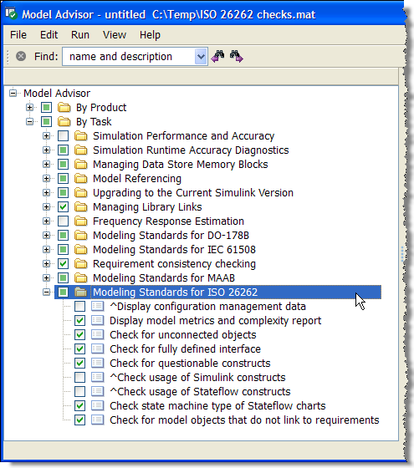
ISO 26262 Modeling Standard Checks
Check models used to develop ISO 26262 certified applications
Checks are based on existing IEC 61508 standards checks, but are adapted for use with ISO 26262
Requires: ‘Simulink Verification and Validation’
www.mathworks.com/support/solutions/en/data/1-DIYI2B/
Notes:
Note: You need Simulink V&V in order to use these checks.

Slide 23
ISO 26262 Reference Workflow Example Tool Chain
Traceability report (Embedded Coder),
Traceability matrix generation (IEC Cert Kit),
Bullseye code coverage integration (Embedded Coder)
Model Advisor (SLVnV),
Property proving (SLDV)
Simulink, Model coverage (SLVnV),
Requirements Management Interface (SLVnV)
PIL testing / CGV (Embedded Coder), Test generation (SLDV)
Simulink, Stateflow, Simulink Fixed Point
Embedded Coder
Notes:
- Tool Chain example (not all steps/tools are mandatory)
- Integrated tool chain, covering both Software development as well as verification and validation)

Slide 24
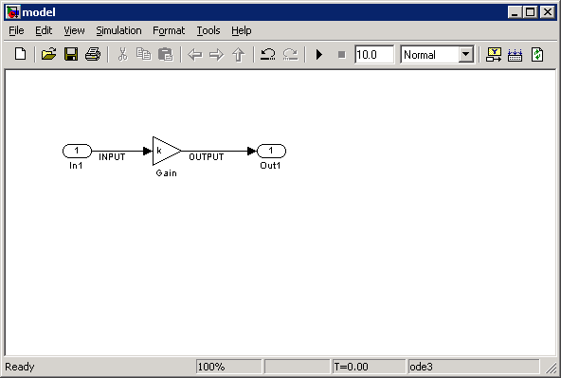
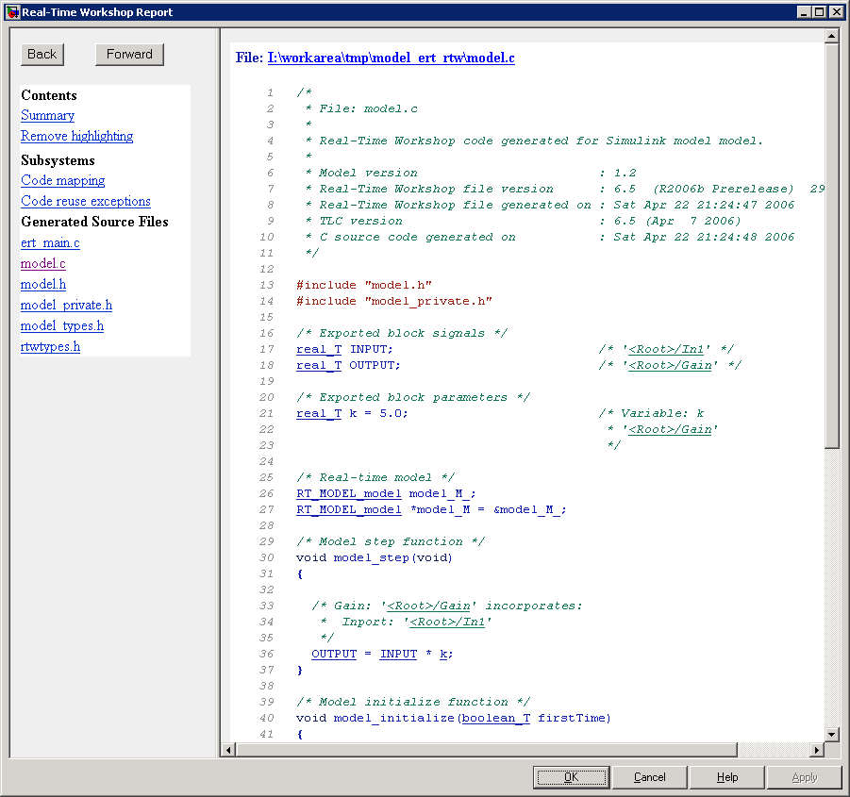
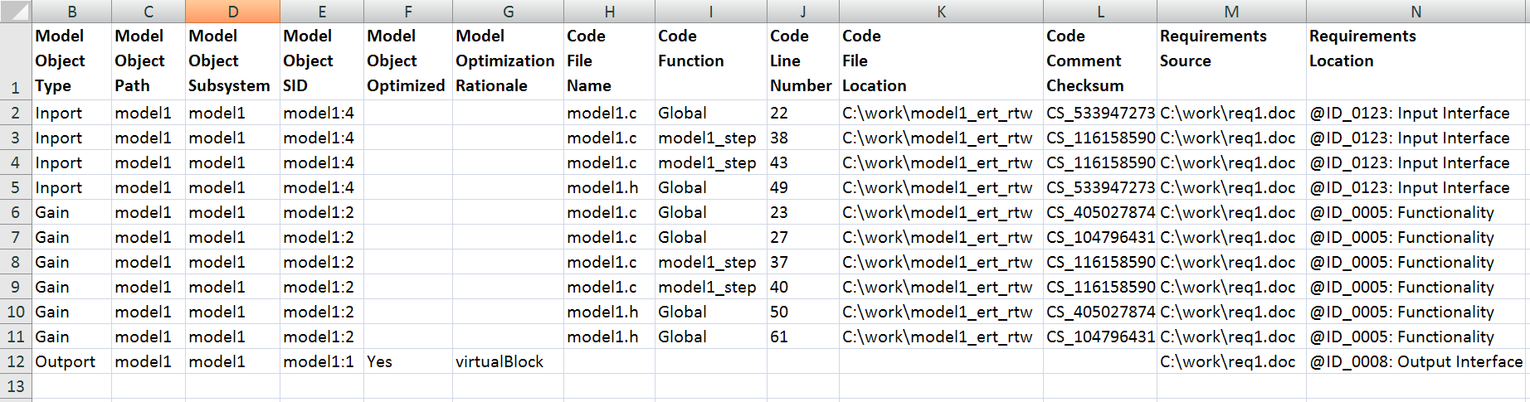
Traceability Matrix Generation
Generate traceability information covering requirements, model elements, and generated code
Use MS Excel to review, track, and annotate generated traceabilty matrices for your project
Fulfill ISO 26262 requirements to document traceability information and to demonstrate absence of unintended functionality (cf. ISO 26262-6, 8.4.6)
Req #1
Req #2
Req #3
Requires: ‘IEC Certification Kit’ for IEC 61508 and ISO 26262; ‘Real-Time Workshop Embedded Coder’

Slide 25
ISO 26262 Reference Workflow Example Tool Chain
Traceability report (Embedded Coder),
Traceability matrix generation (IEC Cert Kit),
Bullseye code coverage integration (Embedded Coder)
Model Advisor (SLVnV),
Property proving (SLDV)
Simulink, Model coverage (SLVnV),
Requirements Management Interface (SLVnV)
PIL testing / CGV (Embedded Coder), Test generation (SLDV)
Simulink, Stateflow, Simulink Fixed Point
Embedded Coder
Notes:
- Tool Chain example (not all steps/tools are mandatory)
- Integrated tool chain, covering both Software development as well as verification and validation)

Slide 26
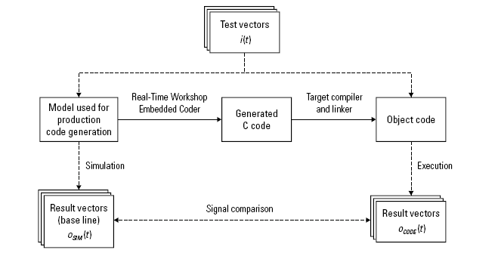
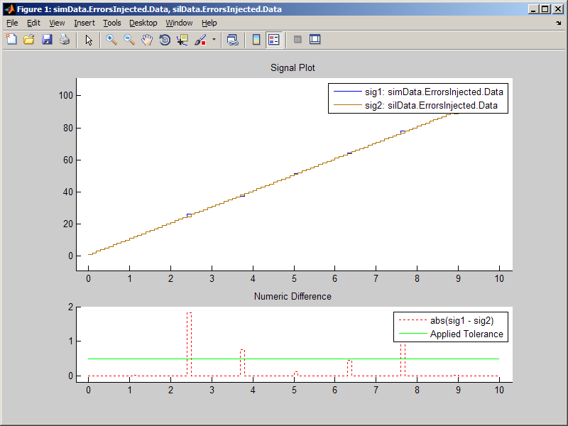
Numeric Code Generation Verification
Challenge
Demonstrate that the model and executable are numerically equivalent
Solution
Automated MATLAB script equivalence testing tool
Numerical results comparison between simulation and SIL/PIL modes
Benefits
Simplifies SIL/PIL usage
Supports ISO 26262 back-to-back-testing objectives
Simulation
SIL/PIL
% Setup
ModelName = 'mQEMdl'; DataSet = 'dQEMdl';
Mode_1 = 'Sim';
Mode_2 = 'topmodel:LinkTS:c166';
cgvObj1 = cgv.CGV(ModelName, Mode_1);
cgvObj1.addInputData(DataSet, 1);
cgvObj2 = cgv.CGV(ModelName, Mode_2);
cgvObj2.addInputData(DataSet, 1);
% Run
cgvObj1.run();
cgvObj2.run();
% Results Comparison
Result1 = cgvObj1.getOutputData(1);
Result2 = cgvObj2.getOutputData(1);

Slide 27
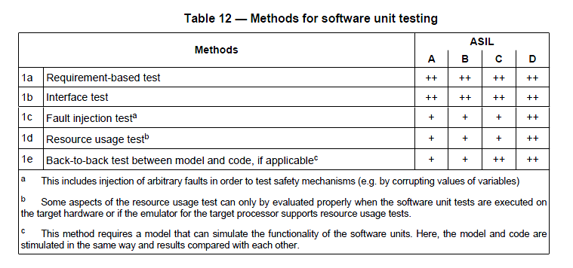
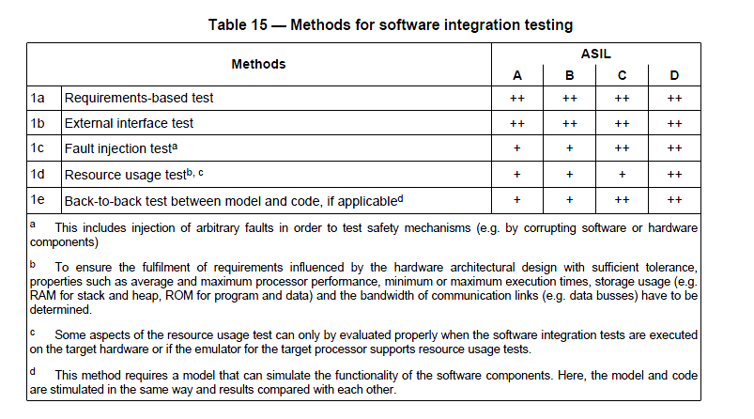
Code Generation Verification in the context of ISO 26262
Support for software unit and integration testing objectives in ISO 26262-6

Slide 28
ISO 26262 Reference Workflow Example Tool Chain
Model Advisor (SLVnV),
Property proving (SLDV)
PIL testing / CGV (Embedded Coder), Test generation (SLDV)
Traceability report (Embedded Coder), Traceability matrix generation (IEC Cert Kit),
Bullseye code coverage integration (Embedded Coder)
Simulink, Model coverage (SLVnV),
Requirements Management Interface (SLVnV)
Simulink, Stateflow, Simulink Fixed Point
Embedded Coder
Notes:
- Tool Chain example (not all steps/tools are mandatory)
- Integrated tool chain, covering both Software development as well as verification and validation)

Slide 29
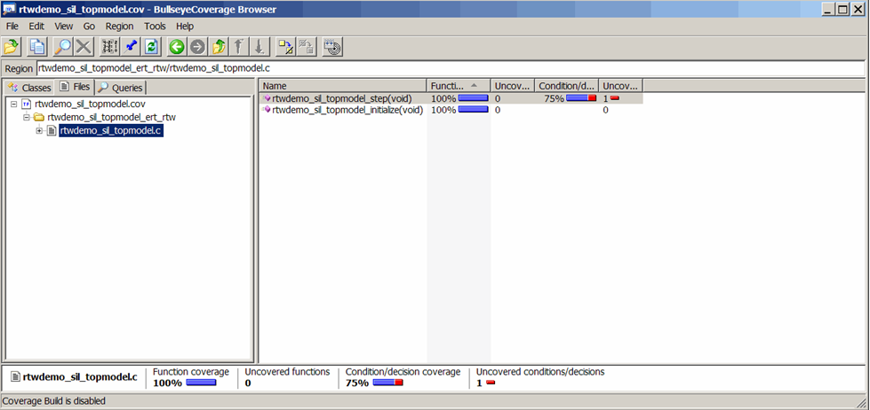
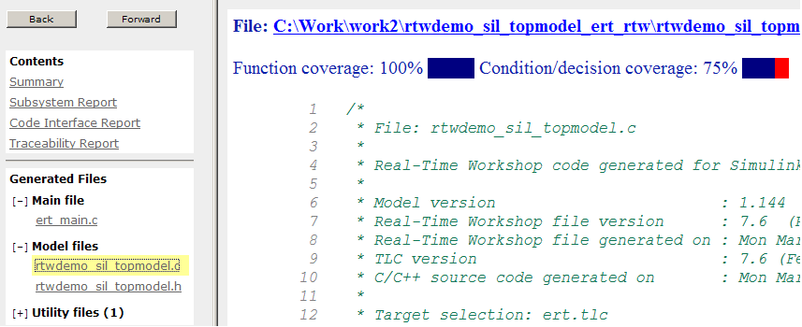
Third-Party Products & Services
BullseyeCoverage from Bullseye Testing Technology
Measurement of coverage metrics for Embedded Coder generated code
www.mathworks.com/help/toolbox/ecoder/ug/bsf5v22.html

Slide 30
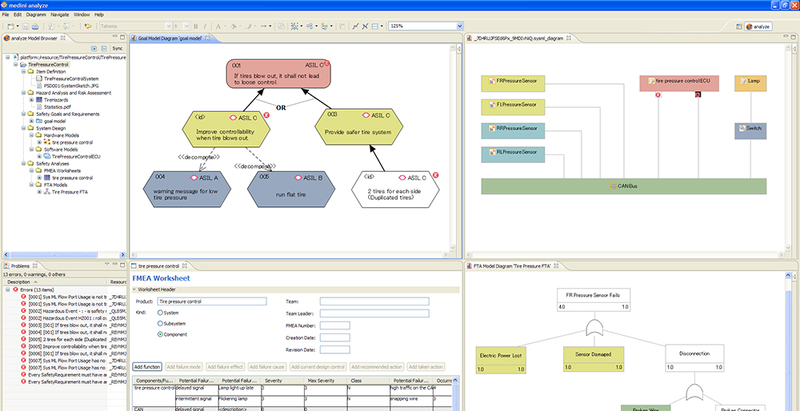
Third-Party Products & Services
medini analyze from ikv++ technologies
Tool for ISO 26262 functional safety analysis activities
ikv++ integrated medini analyze with Simulink. This enables a full Model-Based Design workflow for ISO 26262 based on Simulink, Embedded Coder, and IEC Certification Kit
http://www.mathworks.com/products/connections/product_detail/product_49153.html
Notes:
medini analyze
Functional safety analysis environment implementing ISO 26262
Highlights
Provides a tool for ISO 26262 functional safety analysis activities
Integrates functional safety analysis and development activities
Ensures consistency and rich traceability
Supports ASIL determination and decomposition as well as safety goal and requirements management
Integrates with existing tools
Generate reports (e.g. safety concept)
Click to see enlarged view
Description
The medini™ analyze toolset supports safety analysis and design for software-controlled safety-related functions. It is specifically tailored to ISO DIS 26262 and integrates system architecture design (SysML) and software functional design (MATLAB®, Simulink®, and Stateflow®) with risk and hazard analysis methods—including hazard list, risk graph, fault tree analysis (FTA), and failure mode and effects analysis (FMEA).
Moreover, medini analyze provides central management of all the safety goals and corresponding safety requirements. medini analyze helps users to trace and track all safety-relevant information and decisions throughout the development process.
The tight integration with development tools such as MATLAB, Simulink, and Stateflow guarantees consistency between the artifacts of the architecture, the software functional design, and the artifacts of the safety analysis. The unique integration of functional safety methods and development artifacts by medini analyze provides unequalled rich traceability, change control, and consistency between all models involved. Medini analyze integration with MATLAB and Simulink is provided via COM connectivity.
The integration of Simulink and Stateflow for function modeling enables:
Fine-grained traceability between Simulink and Stateflow model elements and elements of analysis models, such as FTA and FMEA
Creation of FTA events directly from Simulink models
Utilization of Simulink simulation for FMEA controlled fault injection
MathWorks products required
MATLAB
Simulink
MathWorks products recommended
Stateflow
Support
E-mail
Telephone
Platforms
Windows
Industries and Tasks
Automotive
Control Design
Data Modeling, Analysis, Visualization
Process Control and Monitoring
Rail, Ships and other Transportation
Signal Processing
Test and Measurement
IKV Technologies
Dessauer Strasse 28/29 Berlin, 10963 GERMANY Tel: +49-30-3480-770 Fax: +49-30-3480-780 E-mail Web: www.ikv.de

Slide 31
ISO 26262 Reference Workflow Distributed Development
Responsibility for verification and validation of models and generated code can be divided between OEM and supplier
Responsibilities of each party need to be defined and documented (e.g. in ‘Development Interface Agreement (DIA)’)
Each party is responsible for classifying / qualifying their tools

Slide 32
ISO 26262 Reference Workflow Distributed Development - Example
OEM
Supplier
Notes:
Sketch of potential solution only
Would seek approval by TUV

Slide 33
ISO 26262 Reference Workflow Distributed Development – Example II
Distributed development may lead to workflow modifications
OEM
Supplier
Module and integration testing at the model level
Equivalence testing
Prevention of unintended functionality
Review and static analysis at the model level
Notes:
Sketch of potential solution only
Would seek approval by TUV

Slide 34
ISO 26262 Reference Workflow Distributed Development – Documentation
Technique / Measure |  | Associated Requirements | Used / Used to a limited degree / Not used | Interpretation in this application, Evidence | OEM Responsible Accountable Consulting Informed | Supplier R/C/A/I
1 | Model review (See “Reviews and Static Analyses at the Model Level”) | Inclusion of all model components
2 | Adherence to modeling standard (See “Reviews and Static Analyses at the Model Level”) | Designation of a modeling standard Review the modeling standard as fit for purpose Restriction to modeling constructs suited for production code generation Evidence for using the modeling standard
3 | … | …
R
R
Update Conformance Demonstration Template (CDT) to reflect actual workflow (if applicable)
Augment CDT with RCAI matrix

Slide 35
High-Integrity Workflows (ISO 26262)
High-Integrity Applications / Safety Standards / ISO 26262
MathWorks Support for ISO 26262
ISO 26262 and Model-Based Design
Tool Qualification Support
Model-Based Design Workflow and Tool Chain

Slide 36
Tool Qualification Approach
Tool Classification
Tool Qualification
Tool functionality / Use cases
Tool impact
Tool error detection
Tool confidence level
ASIL
Software tool has the possibility to introduce or fail to detect errors
TD 3
No / Low
TCL 3
Qualification measures for TCL3
Increasing qualification requirements
TI 2
Medium
TD 2
UC 1..n
TCL 2
Qualification measures for TCL2
TD 1
High
TI 1
TCL 1
No further qualification measures required
Possibility that the
tool can introduce
errors or fail
to detect them
Confidence in error prevention
and detection measures
Classification of the software tool
into confidence
levels
Tool Qualification Measures
Notes:
Im DIS 4 TCLs, als zu kompliziert wahrgenommen

Slide 37
Tool Qualification Approach
Tool classification must be carried out and documented for all tools
For tools classified at TCL 2 or higher, at least one of the following qualification methods shall be applied and documented
Increased confidence from use
Evaluation of the tool development process
Validation of the software tool
Development in compliance with a safety standard
Tools classified at TCL1 need no qualification measures

Slide 38
Tool Qualification Methods
Recommendation overview of qualification methods for dependent on ASIL level
A software tool classified at TCL1 needs no qualification measures
Method | TCL 2 |  |  |  | TCL 3
 | ASIL A | ASIL B | ASIL C | ASIL D | ASIL A | ASIL B | ASIL C | ASIL D
1a Increased confidence from use | ++ | ++ | ++ | ++ | ++ | ++ | ++ | +
1b Evaluation of the tool development process | ++ | ++ | ++ | ++ | ++ | ++ | ++ | ++
1c Validation of the software tool | + | + | + | + | + | + | + | ++
1d Development in compliance with a safety standard | + | + | + | + | + | + | + | ++
+ … Method recommended
++ … Method highly recommended

Slide 39
Tool Qualification Methods
Selection criteria:
Suitability for all ASILs
Combination of 2+ different methods to ensure robustness w.r.t. expected future changes to ISO 26262
Method | TCL 2 |  |  |  | TCL 3
 | ASIL A | ASIL B | ASIL C | ASIL D | ASIL A | ASIL B | ASIL C | ASIL D
1a Increased confidence from use | ++ | ++ | ++ | + | ++ | ++ | + | +
1b Evaluation of the tool development process | ++ | ++ | ++ | + | ++ | ++ | + | +
1c Validation of the software tool | + | + | + | ++ | + | + | ++ | ++
1d Development in compliance with a safety standard | + | + | + | ++ | + | + | ++ | ++
Source: ISO /DIS 26262-8, 11.4.4.2, Tables 3, 4
+ … Recommended ++ … Highly recommended
Note: Embedded Coder, Simulink Verification and Validation, Simulink Design Verifier, and Polyspace products for C/C++ were not developed using certified processes

Slide 40
Tool Qualification for COTS Tools Workshare
Tool qualification process may involve multiple parties:
Tool user
Responsible for final tool qualification in the context of the application
MathWorks
Carries out generic pre-qualification based on reference workflow
Supports / streamlines user’s activities by providing an ISO 26262 tool qualification kit
Certification Authority
Provides an independent assessment of reference workflow and tool qualification kit
Issues an certificate
Notes:
- In case of COTS tools, knowledge/information about the tool may be shared between tool vendor (capabilities, knowledge about development process, tests) and tool user (actual configuration and environment, integration into overall workflow)
Therefore, actual tool qualification may involve both parties
Tool user: …
Tool vendor: MathWorks can make this process easier
Qual kit artifacts could also incorporate means for the user to reproduce validation tests (e.g. test suite)
Standard doesn’t provide specific recommendations or workflows. -> Rationale for two-stage qualification process

Slide 41
Tool Qualification Workshare
Pre-qualification
Generic tool classification [ MathWorks]
Generic pre-qualification [ MathWorks]
Independent assessment [ Cert. authorithy]
Application-specific adaptation
Review / adaptation of the tool qualification kit [ Tool user ]

ISO 26262 tool qualification kit
Generic work products (pre-filled templates)
Assessment results (assessment report, certificate)

ISO 26262 tool qualification work products
Final work products (completed templates)
Assessment results (assessment report, certificate)
Notes:
Note: The independent assessment is optional (not required by the standard). It could be carried out e.g. by a safety consultant or a cert authorithy (notified body). It is intended to provide additional confidence in the pre-qualification of the tool

Slide 42
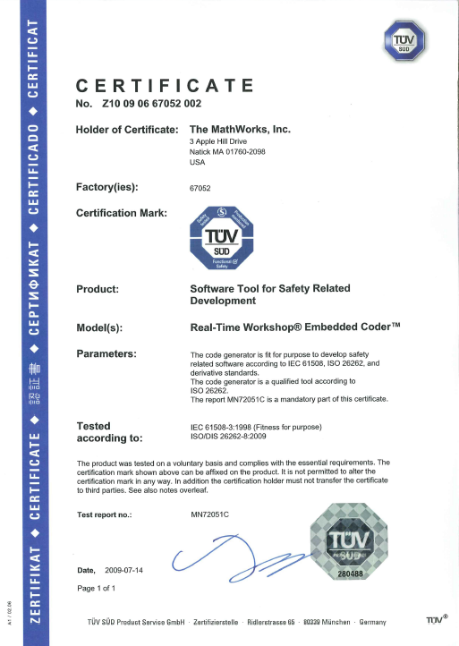
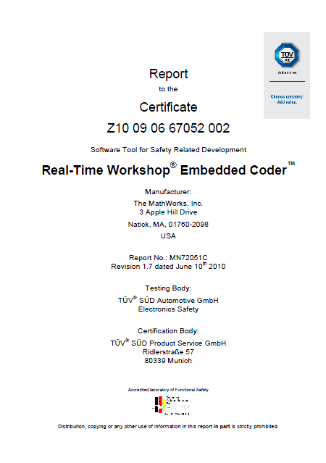
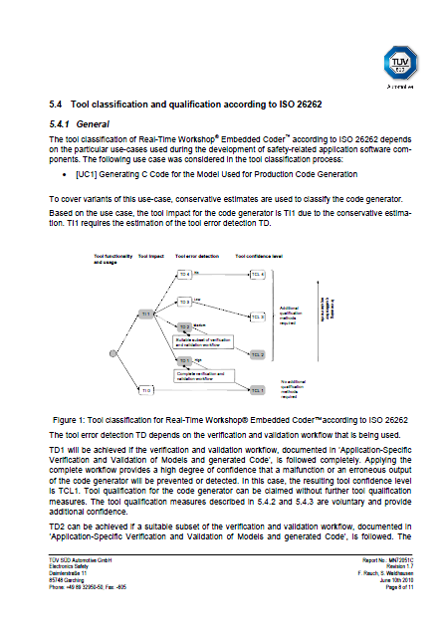
Tool Qualification Assessment Results for Embedded Coder
Certificate
Assesssment report

Slide 43
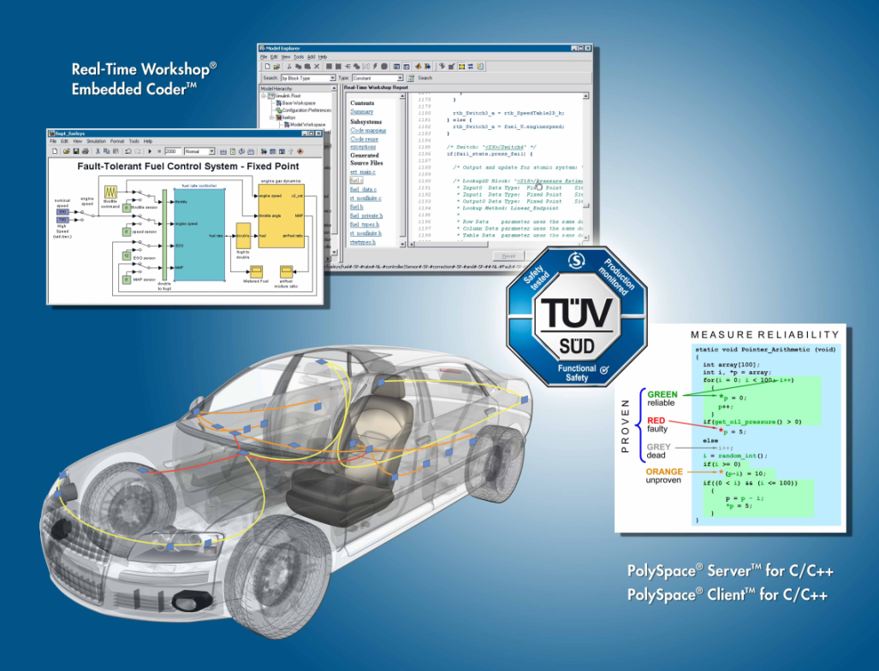
Embedded Coder, Simulink Verification and Validation, Simulink Design Verifier, and Polyspace are pre-qualified for all ASILs acc. to ISO 26262

Slide 44
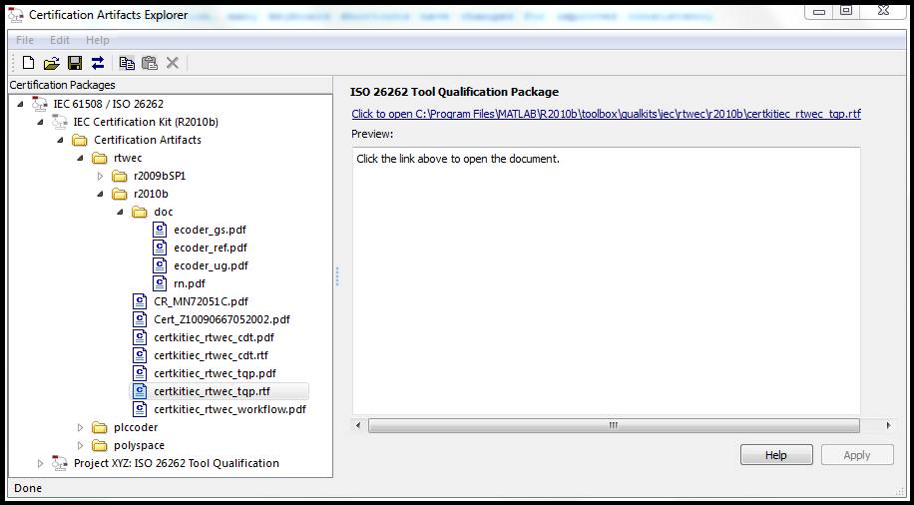
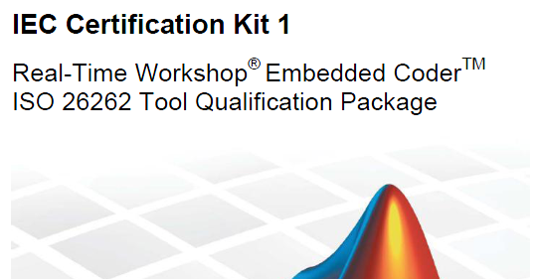
The IEC Certification Kit product allows users to re-use and adapt the pre-qualification results for their ISO 26262 projects
Evidence for independent assessment
Assessment report
Certificate
Templates for tool qualification work products
Reference workflow with conformance demonstration template
Requires: ‘IEC Certification Kit’; available for R2008a– R2011a
www.mathworks.com/products/iec-61508/
Notes:
-Tool Qual Kit covers Polyspace products for C/C++ as well
- Tool qualification can be claimed by creating an application-specific version of the tool qualification package and referencing the certificate/certification report

Slide 45
IEC Certification Kit
(Includes ISO 26262 Tool Qualification Kit)
Supports engineers who use MathWorks™ products to develop, verify, or validate software for systems that must comply with, or be certified according to ISO 26262
Support for tool qualification
Pre-filled templates for ISO 26262-8 tool qualification work products
Evidence of independent assessment (certificates, assessment reports)
Tool for managing qualification artifacts (Certification Artifacts Explorer)
Support for certification-related software development activities
Reference Workflow with Conformance Demonstration Template
Utility functions (Traceability matrix generation)
The IEC Certification Kit product also provides support for the IEC 61508 base standard and other application specific standards

Slide 46
IEC Certification Kit Benefits
Without IEC Certification Kit | With IEC Certification Kit
(For all tools used) User need to provide documentation and installation instructions | (For all tools covered by the kit) MathWorks provides required documentation and installation instructions
User needs to document development processes the tools are embedded into | (For all tools covered by the kit) MathWorks provides reference workflow describing typical development process and conformance demonstration template (CDT); User only needs to describe and justify deviations from the reference workflow and document compliance with the workflow by completing the CDT
(For all tools used) User needs to carry out tool classification and determine TCL | (For all tools covered by the kit) MathWorks provides generic pre-classification and independent assessment; user only needs to verify assumptions in the pre-classification
(For al tools used) User needs to document tool classification | (For all tools covered by the kit) MathWorks provides pre-filled template for tool classification work product; user only needs to complete the template
(For tools with TCL 2 or higher) User needs to perform tool qualification measures (typically involves creation of a test suite) | (For all tools covered by the kit) MathWorks provides evidence for pre-qualification and independent assessment
(For tools with TCL 2 or higher) User needs to document tool qualification | (For all tools covered by the kit) MathWorks provides pre-filled template for tool qualification work product; user only needs to complete the template
 | Plus: MathWorks provides additional utility functions (e.g. trace matrix export)

Slide 47
MathWorks Support for ISO 26262 Summary
Development Process and Tool Chain
Integrated Model-Based Design tool chain for ISO 26262
Simulink, Stateflow
Real-Time Workshop Embedded Coder
Model V&V tools, PolySpace code verification products
IEC Certification Kit
ISO 26262 reference workflows
ISO 26262 utilities (ISO 26262 checks, trace matrix generation)
Tool Qualification
Additional confidence in MathWorks tools by tool qualification according to ISO 26262
We look forward to collaborating with you

Slide 48
Agenda
10:00 - 11:00 Model-Based Design for ISO 26262
11:00 - 11:15 Coffee Break
11:15 - 12:30 Using Simulink for Software Design
12:30 - 13:30 Lunch
13:30 - 15:00 Design Verification
15:00 - 15:15 Coffee Break
15:15 - 16:15 Code Verification
16:15 - 16:30 Summary and Close

Slide 49

The MathWorks
Change the world by
Accelerating the pace
of discovery, innovation, development, and learning
in engineering and science

Slide 50
New and Extended Model Advisor Capabilities
Model Advisor Configuration Editor (R2009b)
More robust hyperlinks in HTML report (R2010a)
Model Advisor command line API (R2010b)
Multicore support (R2010b)

Slide 51
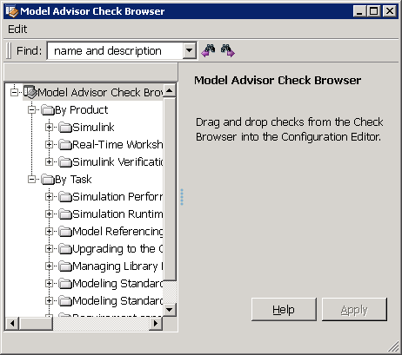
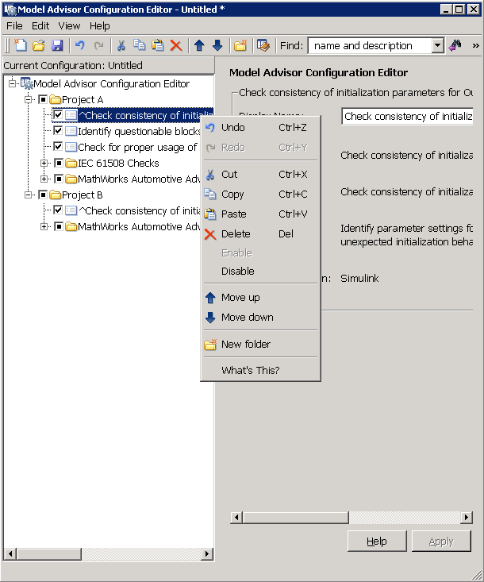
Model Advisor Configuration Editor
R2009b
Create and maintain Model Advisor check configurations
GUI to create custom configurations
GUI to browse available checks
Configuration load and save (via MAT-file)
Benefits:
Saves time creating custom configurations
Allows deployment of multiple configurations
Check Browser
Configuration Editor
Notes:
Motivation
Customers often have difficulties customizing Model Advisor for their environments. Customers want to regroup checks and/or hide checks. To do that, the current approach requires hand writing an MATLAB file. A GUI based approach is a far better choice.
Doc Reference
This is documented in Simulink V&V doc.
Demo
Start Model Advisor on any demo model, go to File menu → Open Configuration Editor
Limitations, Known Problems, and Workarounds
This tool can not create new custom checks. Creating new checks still requires MATLAB programming.
Questions and Debugging Tips (for MathWorks Support team)
To reset default configuration, use File menu→ Restore default configuration. Or go to MATLAB preferences directory (which you can get by “prefdir” command), remove mdladvprefs.mat file there.
Release Number – R2009b

Slide 52
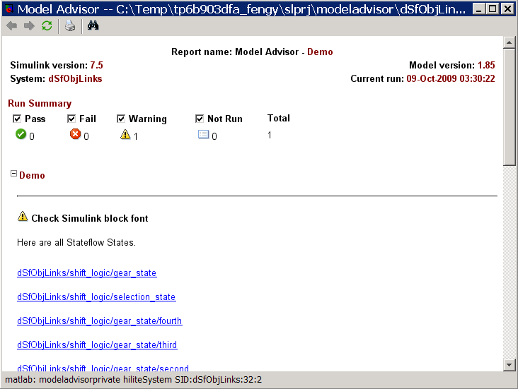
Persistent Hyperlinks in Model Advisor HTML Report
Robust hyperlinks across MATLAB sessions
Most HTML hyperlinks to Simulink and Stateflow objects in Model Advisor report are now persistent across MATLAB sessions
Leverages Simulink Identifier technology
Increases usability of stored Model Advisor reports
Notes:
Must be suitable for customers as the slide will be made available for external use at the time of release.
Motivation
One or two sentences describing the problem in terms of how customers phrased or think of the issue. Consider both the feature and the workflow motivations.
Solution (Added Details)
More details as appropriate. How does it integrate with other features and products?
Doc Reference
In addition to release notes, which should be the source for most of the information on this slide. Add a doc reference if possible.
Demo
E.g. check “Identify blocks that generate expensive saturation and rounding code”.
Limitations, Known Problems, and Workarounds
There are still some cases when links don’t work across sessions.
Questions and Debugging Tips (for MathWorks Support team)
What questions might end users ask?
What should Support try out when end users run into problems?
Are there any debugging tips or processes Support should follow?
Release Number – Tech Marketing to add icon closer to release date.
52

Slide 53

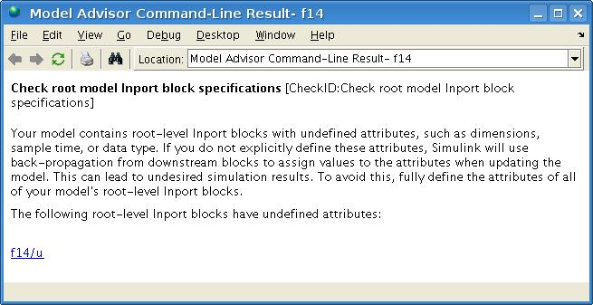
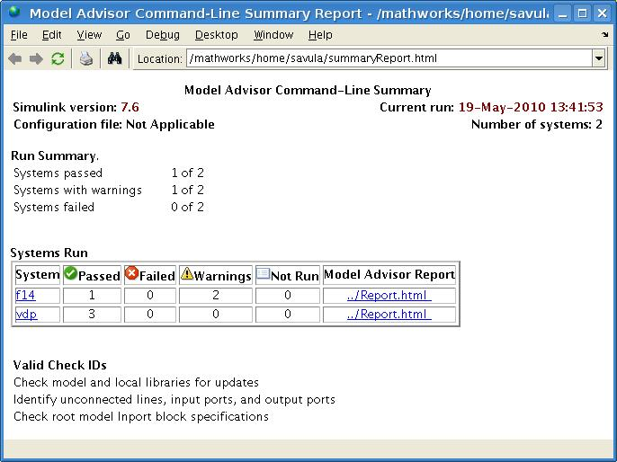
Model Advisor Batch Mode Operation
>> ResultObjs = ModelAdvisor.run(mdlList,checkIDList,'DisplayResults','Details')
Running Model Advisor
Running Model Advisor on vdp
Running Model Advisor on f14
============================================================
Model Advisor run: 19-May-2010 13:42:15
Configuration: None
System: f14
System version: 7.6
Created by: The MathWorks Inc.
============================================================
(1) Warning: Check model, local libraries, and referenced models for known upgrade issues [check ID: …]
------------------------------------------------------------
(2) Pass: Identify unconnected lines, input ports, and output ports [check ID: …]
------------------------------------------------------------
(3) Warning: Check root model Inport block specifications [check ID: …]
------------------------------------------------------------
Summary: Pass Warning Fail Not Run
1 2 0 0
============================================================
[…]
Systems passed: 1 of 2
Systems with warnings: 1 of 2
Systems failed: 0 of 2
Summary Report
ResultObjs =
[1x1 ModelAdvisor.SystemResult] [1x1 ModelAdvisor.SystemResult]
New Model Advisor Command Line API
Run any set of Model Advisor checks on any number of models
Specify checks by ID or based on a Model Advisor configuration
Multicore enabled with Parallel Computing Toolbox
Notes:
Checking Systems Programmatically With the Model Advisor
Previously, you could check systems programmatically using the
Simulink.ModelAdvisor class, requiring many steps to check only one
system at a time. Now you can check systems using the ModelAdvisor.run
function. Using this function, you can create a MATLAB file for distribution
that specifies a list of checks or a Model Advisor configuration file to run
against any number of systems simultaneously.
Additionally, the following functions are available for reviewing results. You
can use these functions to determine which checks failed on which systems
and archive the results for accessing at a later time.
If you have a Parallel Computing Toolbox™ license and a multicore machine,
to improve performance, you can run the Model Advisor on multiple systems
in parallel.
For details, see the ModelAdvisor.run reference page and “Checking
Systems with the Model Advisor” in the Simulink Verification and Validation
documentation.
Motivation
Easy way to run Model Advisor checks for multiple models. Review and archive results.
Solution (Added Details)
Run Model Advisor checks on multiple models using checkID array or a configuration file. For obtaining checkID’s of checks use the ‘Send ID to workspace’ option for each node in Model Advisor (on Right-Click).
cmdLineRun = ModelAdvisor.run(mdlList, checkIDList, 'verbose', 'on')
cmdLineRun = ModelAdvisor.run(mdlList , ‘-configuration’, ‘conf.mat’, 'verbose', 'on')
Limitations, Known Problems, and Workarounds
Running Model Advisor in parallel requires Parallel Computing Toolbox
Release Number – R2010b

Slide 54
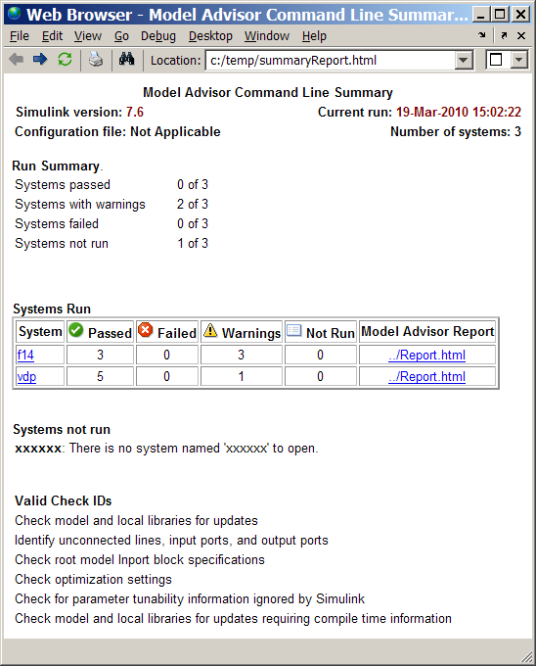
Model Advisor Batch Reports
Flexible reporting and archiving capabilities
Review and archive results from command line runs
View results in command window or Web browser
Export archived results to Web browser or Model Advisor
New summary report for multiple models
Notes:
Motivation
Review and archive capabilities
Solution (Added Details)
To review run results for multiple models, a new summary report is generated. Also, capability to export returned objects to model advisor is available.
Release Number – R2010b

Slide 55

Guidelines and Guideline Checks
Guidelines
MAAB modeling guidelines (minor update for 9b)
MathWorks modeling guidelines for high-integrity systems (new in 9b)
MathWorks modeling guidelines for Real-Time Workshop Embedded Coder (new in 10b)
Standards Checks
MAAB
ISO 26262
IEC 61508
MISRA-C (new in 10a)
Notes:
These are the industry standard guidelines that the models can be verified against:
The style guidelines by MAAB (which stands for the MathWorks Automotive Advisory Board )
There are checks for the MathWorks guidelines for DO-178B standard and the IEC 61508 standard. These guidelines are an implementable subset of checks on the model that enable the generation of code that complies with industry standards.
Recently we added checks and guidelines to

Slide 56
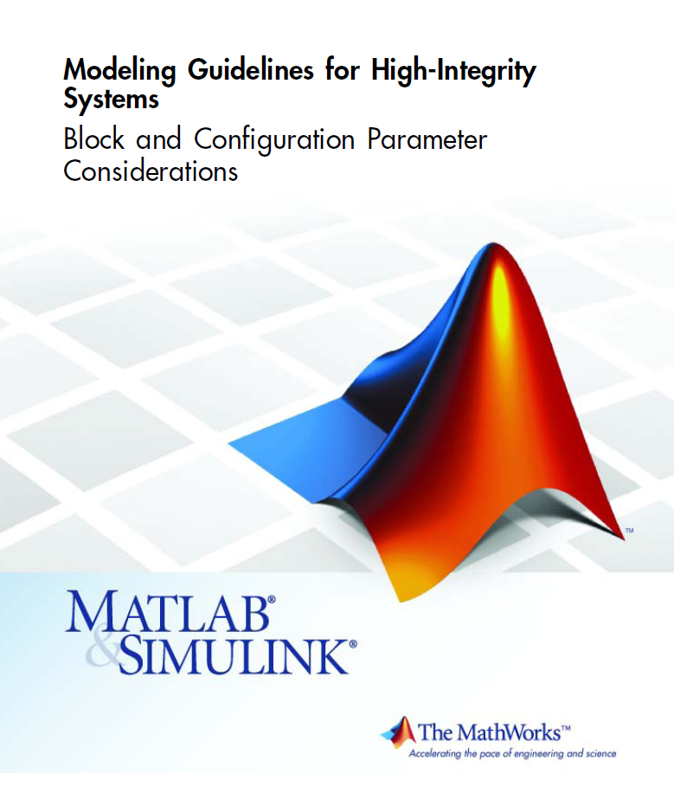
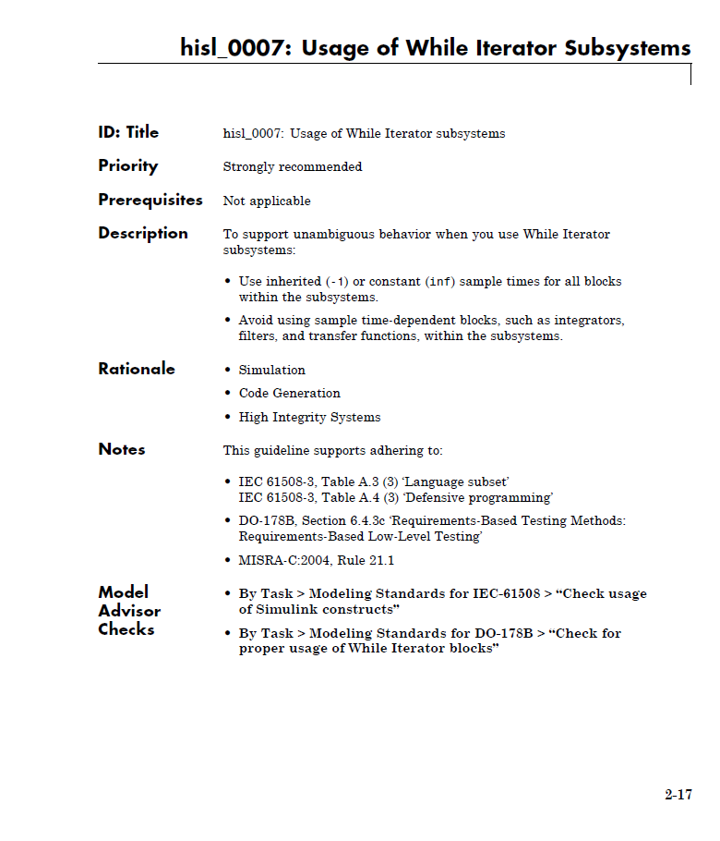
Modeling Guidelines for High-Integrity Systems
R2009b
Leverage industry best practices and MathWorks tool expertise when developing high-integrity systems
Modeling Guidelines and corresponding Model Advisor checks to facilitate modeling standards and guidelines objectives of ISO 26262, IEC 61508,, and DO-178B
Notes:
Motivation
One or two sentences describing the problem in terms of how customers phrased or think of the issue. Consider both the feature and the workflow motivations.
Solution (Added Details)
More details as appropriate. How does it integrate with other features and products?
Doc Reference
In addition to release notes, which should be the source for most of the information on this slide. Add a doc reference if possible.
Demo
Shipping demo name
Limitations, Known Problems, and Workarounds
What are the current limitations? Are there problems end users are likely to run into? Are there Workarounds? Is anything likely to break, not just feature or product but interoperability with other products?
Questions and Debugging Tips (for MathWorks Support team)
What questions might end users ask?
What should Support try out when end users run into problems?
Are there any debugging tips or processes Support should follow?
Release Number – Tech Marketing to add icon closer to release date.

Slide 57
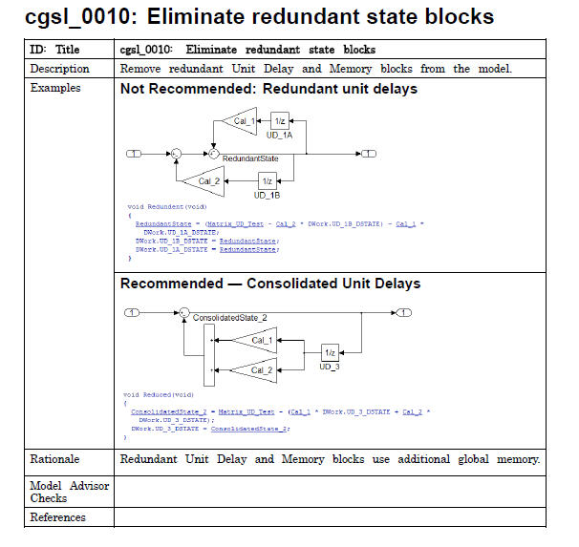
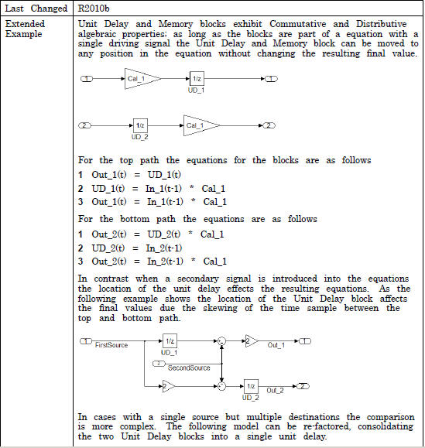
Modeling Guidelines for Real-Time Workshop Embedded Coder
Leverage industry and MathWorks tool code generation expertise
Modeling patterns for efficent code
Tradeoffs in design decisions
Guidelines provide:
Concise actionable summary of recommendations
Rationale behind recommendations

Slide 58
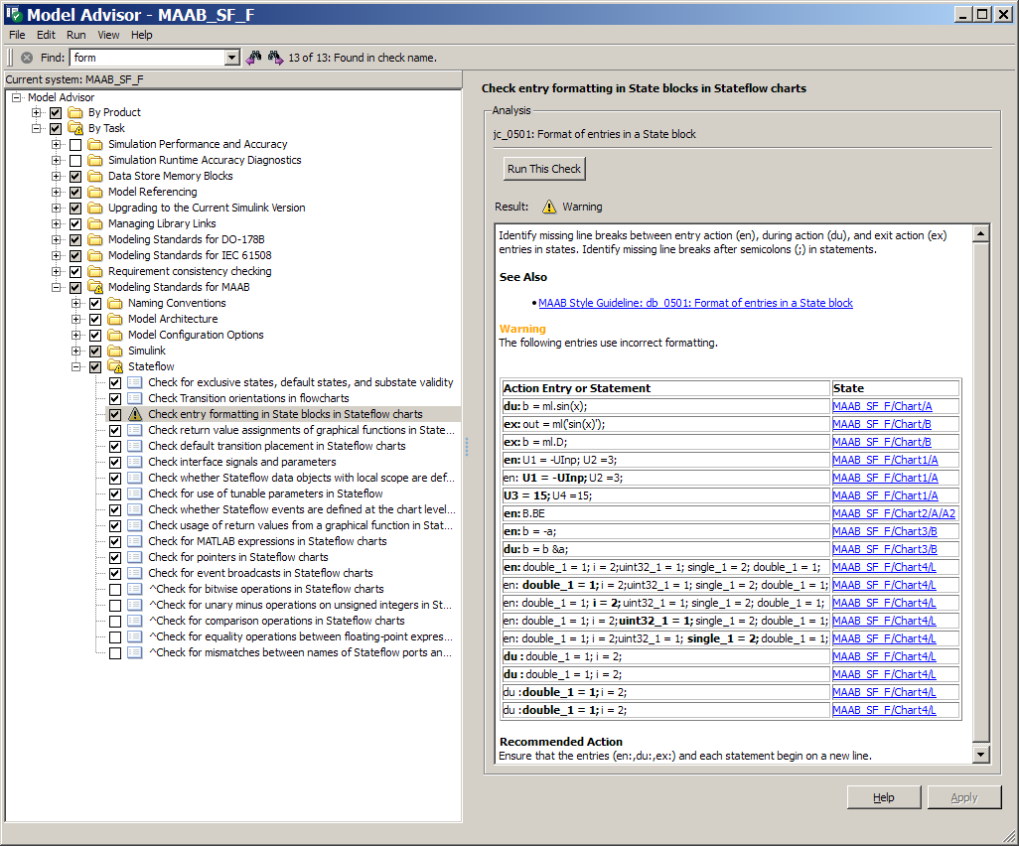
Enhanced Stateflow Checking
Check Stateflow charts for compliance with MAAB rules and High-Integrity guidelines
Enhanced semantics analysis of Stateflow charts
11 new or improved Stateflow checks for MAAB rules
2 new or improved Stateflow checks for IEC 61508
Notes:
• “Check usage of return values from a graphical function in Stateflow charts”
• “Check for pointers in Stateflow charts”
• “Check for event broadcasts in Stateflow charts”
• “Check for MATLAB expressions in Stateflow charts”
• “Check for bitwise operations in Stateflow charts”
• “Check for comparison operations in Stateflow charts”
• “Check for unary minus operations on unsigned integers in Stateflow charts”
• “Check for equality operations between floating-point expressions in Stateflow charts”
• “Check transition actions in Stateflow charts”.

Slide 59
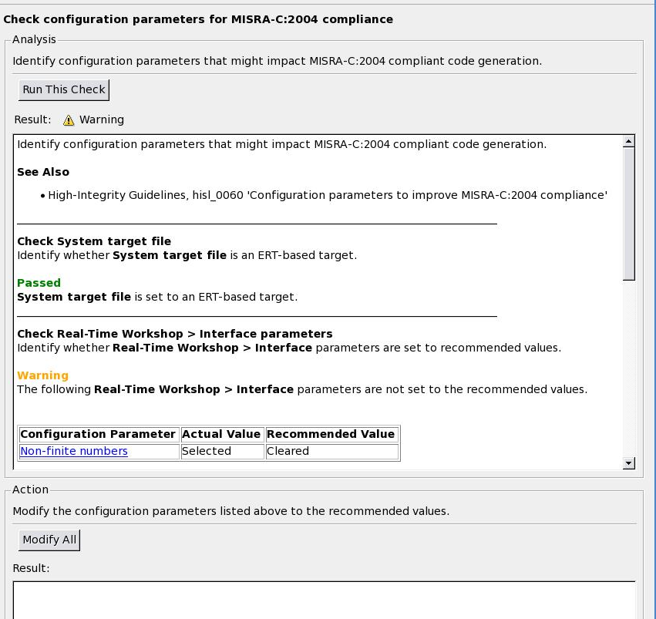
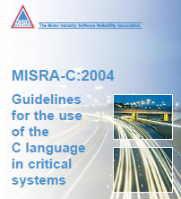
MISRA-C:2004 Compliance Checks
Increase MISRA-C:2004 compliance of generated code
New Model Advisor checks to
Identify blocks not recommended for MISRA-C:2004 compliance
Recommend configuration parameter settings
Enhance MISRA-C:2004 compliance of Real-Time Workshop Embedded Coder code at the model level
Notes:
Must be suitable for customers as the slide will be made available for external use at the time of release.
Motivation
One or two sentences describing the problem in terms of how customers phrased or think of the issue. Consider both the feature and the workflow motivations.
Solution (Added Details)
More details as appropriate. How does it integrate with other features and products?
Doc Reference
In addition to release notes, which should be the source for most of the information on this slide. Add a doc reference if possible.
Demo
No shipping demo in R2010a
Open any model set up for code generation using an .ert target
Start Model Advisor
Go to By Product > Real-Time Workshop Embedded Coder
Select and run the following checks
- Check configuration parameters for MISRA-C:2004 compliance
- Check for blocks not recommended for MISRA-C:2004 compliance
Limitations, Known Problems, and Workarounds
Note: Passing these checks doesn‘t guarantee MISRA-C:2004 compliance. There are other influencing factors as well that won‘t be or cannot be checked.
See the MathWorks MISRA-C:2004 Comppliance Documentation for further information on increasing MISRA-C:2004 compliance of generated code
Run the PolySpace MISRA C (R) checker on your final code to assess MISRA-C:2004 compliance
Questions and Debugging Tips (for MathWorks Support team)
What questions might end users ask?
What should Support try out when end users run into problems?
Are there any debugging tips or processes Support should follow?
Release Number – Tech Marketing to add icon closer to release date.

Slide 60
MathWorks Support for ISO 26262 Summary
Integrated Model-Based Design tool chain for ISO 26262
Simulink, Stateflow
Model V&V tools
Real-Time Workshop Embedded Coder
Polyspace code verification products
IEC Certification Kit
Tool qualification and certification support with IEC Certification Kit
Connection partners for ISO 26262
Various improvements regarding workflows & guidelines for HIS
Participation in the standardization activities for ISO 26262-6/8 and discussions with automotive companies

